Slide 1
Repeated-measures designs (GLM 4)
Chapter 13

Slide 2
Terms
Between subjects = independent
Each subject gets only one level of the variable.
Repeated measures = within subjects = dependent = paired
Everyone gets all the levels of the variable.

Slide 3
RM ANOVA
Now we need to control for correlated levels though …
Before all levels were separate people (independence)
Now the same person is in all levels, so you need to deal with that relationship.

Slide 4
RM ANOVA
Sensitivity
Unsystematic variance is reduced.
More sensitive to experimental effects.
Economy
Less participants are needed.
But, be careful of fatigue.

Slide 5
RM ANOVA
Back to this term: Sphericity
Relationship between dependent levels is similar
Similar variances between pairs of levels
Similar correlations between pairs of levels
Called compound symmetry
The test for Sphericity = Mauchly’s
It’s an ANOVA of the DIFFERENCES in variance scores.

Slide 6
RM ANOVA
You will NOT need to examine sphericity if you have only two levels.
Why?

Slide 7
RM ANOVA
It is hard to meet the assumption of Sphericity
In fact, most people ignore it.
Why?
Power is lessened when you do not have correlations between time points
Generally, we find Type 2 errors are acceptable

Slide 8
RM ANOVA
Basic data screening: accuracy, missing, outliers
Outliers note … now you will screen all the levels … why?
Multicollinearity – only to make sure it’s not r = .999+, otherwise will not run
Normality
Linearity
Homogeneity (NOT Levene’s, but Mauchly’s Sphericity)
Homoscedasticity

Slide 9
RM ANOVA
What to do if you violate it (and someone forces you to fix it)?
RM ANOVA with corrections
MANOVA
Multilevel Model

Slide 10
RM ANOVA
Corrections – note these are DF corrections → which affect the cut off score (you have to go further) → which lowers the p-value

Slide 11
RM ANOVA
Corrections:
Greenhouse-Geisser
Huynh-Feldt
Which one?
When ε (sphericity estimate) is > .75 = Huynh-Feldt
Otherwise Greenhouse-Geisser

Slide 12
An Example
Are some Halloween ideas worse than others?
Four ideas tested by 8 participants:
Haunted house
Small costume (brr!)
Punch bowl of unknown drinks
House party
Outcome:
Bad idea rating (1-12 where 12 is this was dummmbbbb).

Slide 13
Variance Components

Slide 14
Variance Components
SStotal = Me – Grand mean (so this idea didn’t change)
SSwithin = Me – My level mean (this idea didn’t change either)
BUT I’m in each level and that’s important, so …

Slide 15
Variance Components
SSwithin = SSm + SSr
SSm = My level – GM (same idea)
SSr = SSw – SSm (basically, what’s left over after calculating how different I am from my level, and how different my level is the from the grand mean)

Slide 16
Variance Components
SSbetween?
Represents individual differences between participants
SSb = SSt - SSw

Slide 17
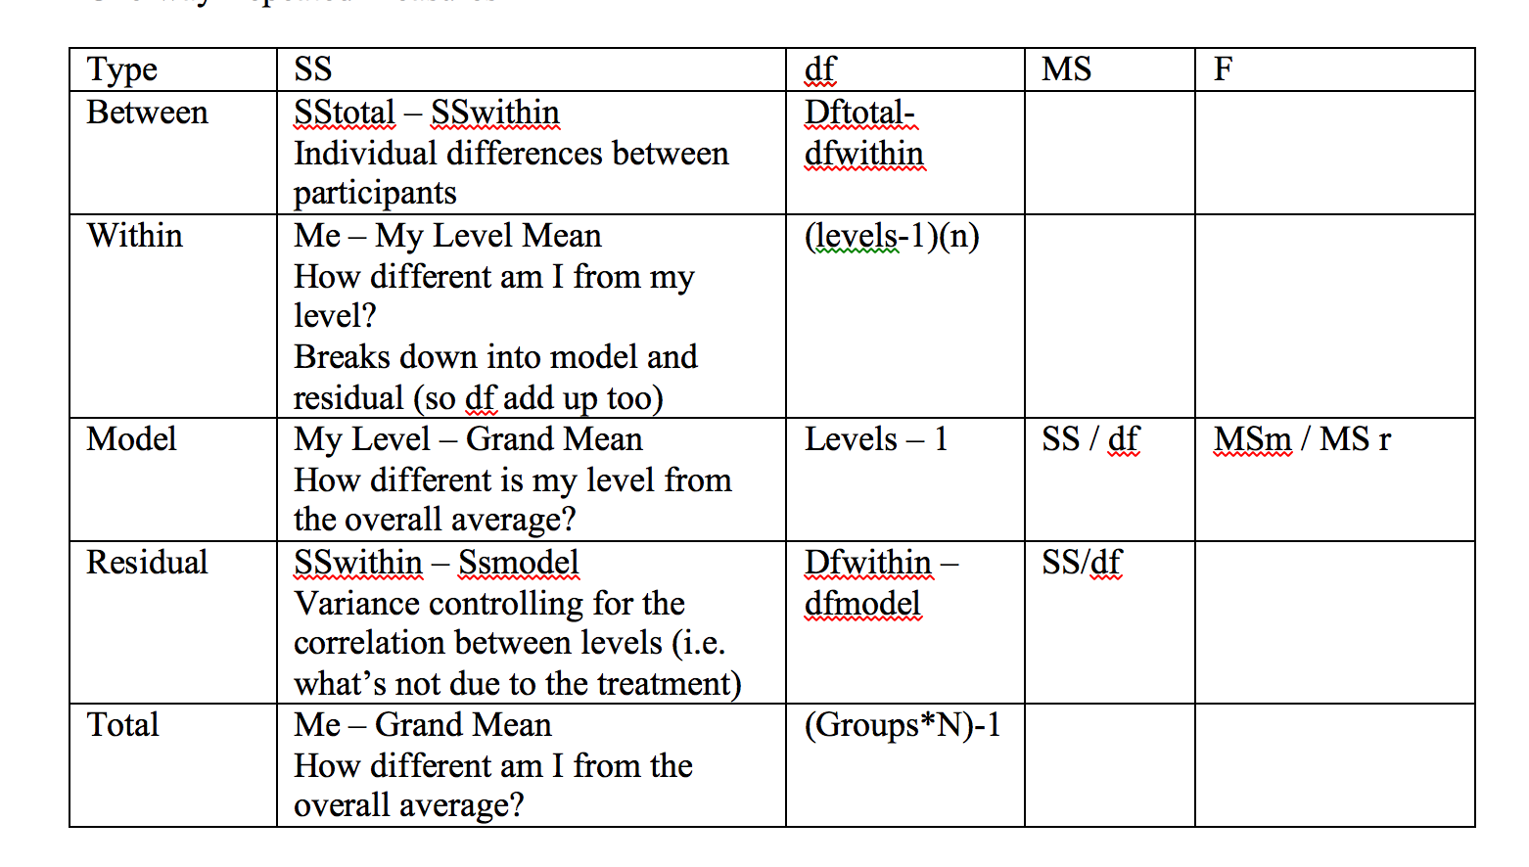

Slide 18
How to R
Data screening = run with wide format (if you can)
Analysis = must be in long format, and you MUST have a participant number!

Slide 19
How to R
To run repeated measures (traditional style), you can install ez to run ezANOVA.

Slide 20
How to R
Output = ezANOVA(data,
dv = dv,
wid = participant number,
within = RM IV,
between = BN IV,
detailed = TRUE,
type = 3)

Slide 21
How to R
Since we are using a different function, of course the summary is different.
Just type output to see everything.

Slide 22
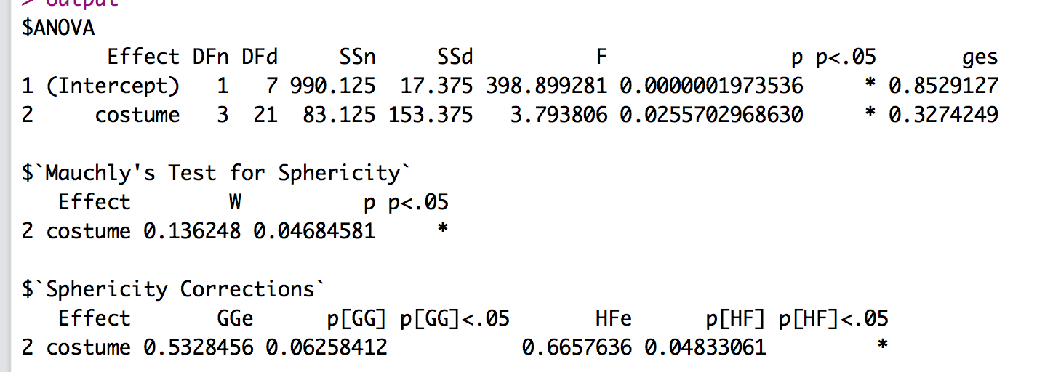
How to R
F(3, 21) = 3.79, p = .03, n² = .33

Slide 23
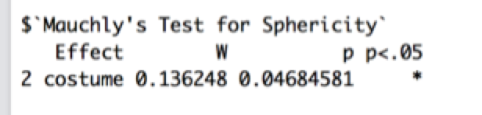
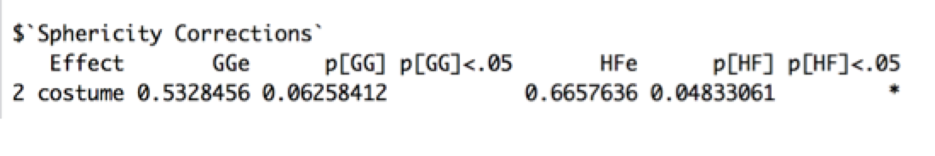
Correction?
Is it necessary?
Not by our data screening rules.
How do corrections work?

Slide 24
Correction?
Since HF < .75, I would use GG if I wanted to correct.
NOTE: traditionally, people would report the corrected df values.
However, since these values are readily obvious here, you could just say Greenhouse-Geiser corrected p value and report the regular F.
F(3, 21) = 3.79, p = .03, Greenhouse-Geiser p = .06

Slide 25
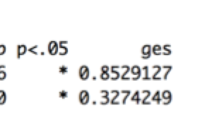
Effect Size
Eta squared = formula is still SSm / SSt
But SSt is a big pain in RM

Slide 26
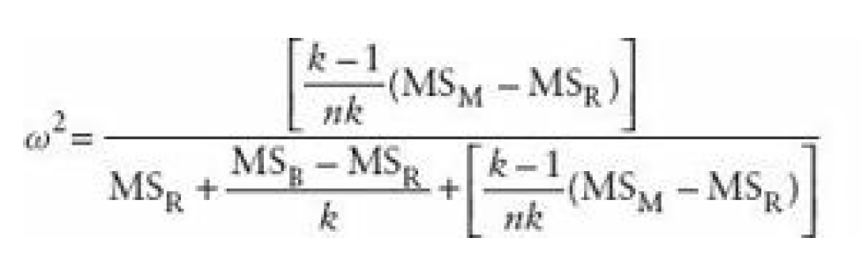
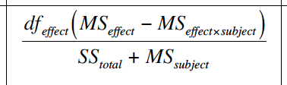
Effect Size
Omega squared is evil.
Let’s just not.

Slide 27
Post Hocs
Remember, this analysis is one-way repeated measures!
Because of the repeated measures part, we have to deal with independence in the post hoc as well.

Slide 28
Post Hoc Options
Things to get straight:
Post hoc test: dependent t
Why? Because it’s repeated measures data
Post hoc correction: Bonferroni
Only the BON?
Tukey is another option but requires a bit more coding.

Slide 29
Post Hoc Options
Bonferroni:
pairwise.t.test(DV,
IV,
paired = TRUE,
p.adjust.method = "bonferroni")

Slide 30
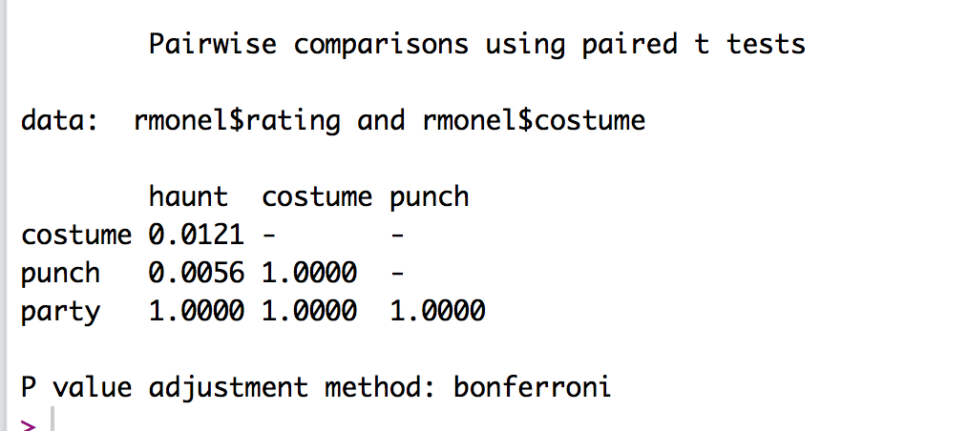
Post Hoc Options
Bonferroni output

Slide 31
Post Hoc Options
Tukey
First run test as MLM:
Load the nlme package.
output2 = lme(Y ~ X,
random = ~1 | participant number,
data = data,
method = “ML”)

Slide 32
Post Hoc Options
Then, run a Tukey test using glht().
Load the multcomp() library.
tukey = glht(saved output,
linfct = mcp(IV = "Tukey"))
summary(tukey)

Slide 33
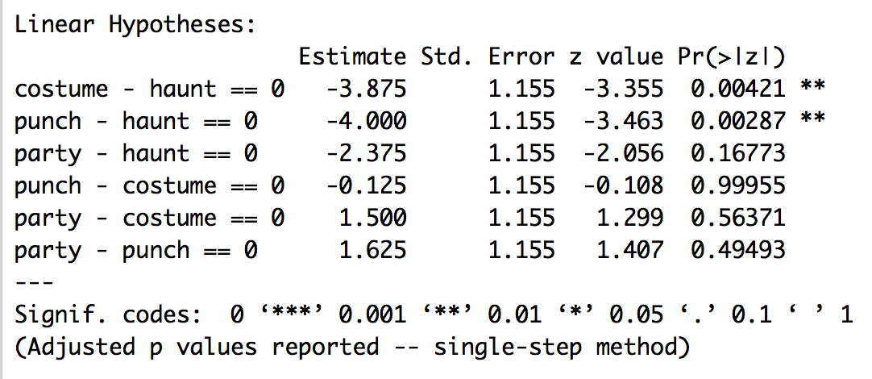
Post Hoc Options

Slide 34
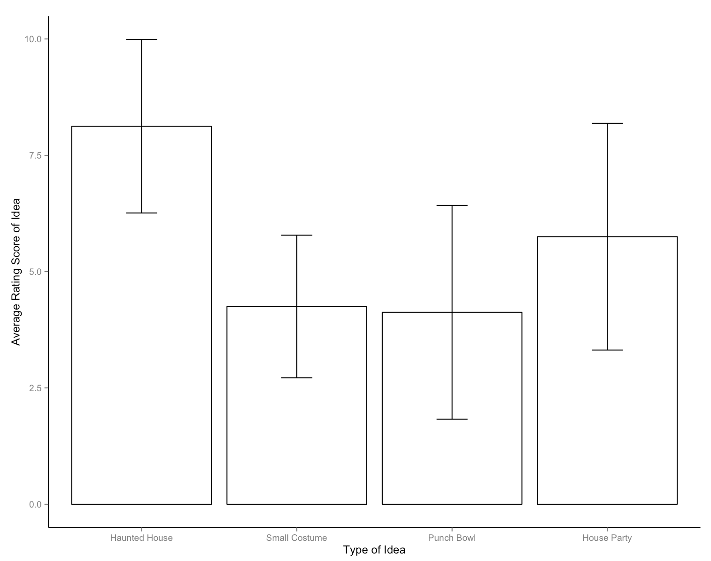

Slide 35
Two-Way Repeated Measures ANOVA
Chapter 14

Slide 36
What is Two-Way Repeated Measures ANOVA?
Two Independent Variables
The same participants in all conditions.
Repeated Measures = ‘same participants’
A.k.a. ‘within-subjects’
Remember, we talked about using #X# repeated measures to describe the analysis.

Slide 37
An Example
Field (2013): Effects of advertising on evaluations of different drink types.
IV 1 (Drink): Beer, Wine, Water
IV 2 (Imagery): Positive, negative, neutral
Dependent Variable (DV): Evaluation of product from -100 dislike very much to +100 like very much)

Slide 38
SS_{T}
Variance between all participants
SS_{M}
Within-Participant Variance Variance explained by the experimental manipulations
SS_{R}
Between-Participant Variance
SS_{A}
Effect of Drink
SS_{B}
Effect of Imagery
SS_{A × B}
Effect of Interaction
SS_{RA}
Error for Drink
SS_{RB}
Error for Imagery
SS_{RA × B}
Error for Interaction

Slide 39
How to R
Set up the data
Add a participant number
Melt the data
Fix the columns
gl function
gl(# levels, # cases in each level, labels = c(“stuff”))
gl(# levels, # cases in each level, # total cases, labels = c(“stuff”))

Slide 40
How to R
Using the ezANOVA function, we will now just add more variables
You just wish it were the * operator.
RM is just generally a big pain.
Change within to within = .(var, var)

Slide 41
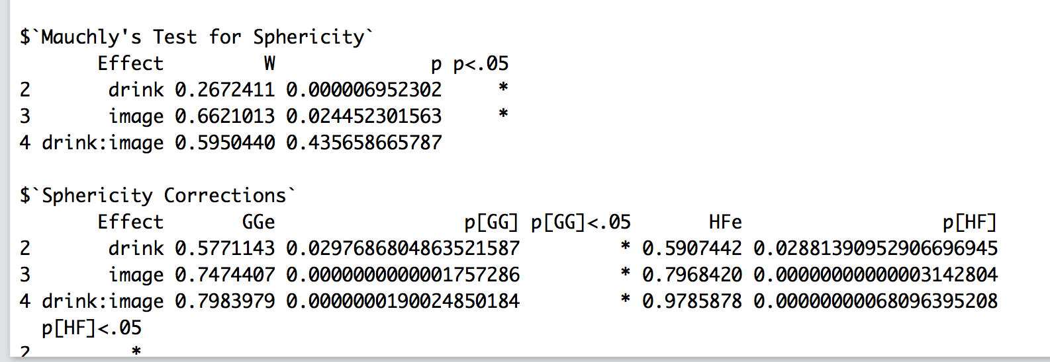
Definitely need to fix (a) drink!

Slide 42
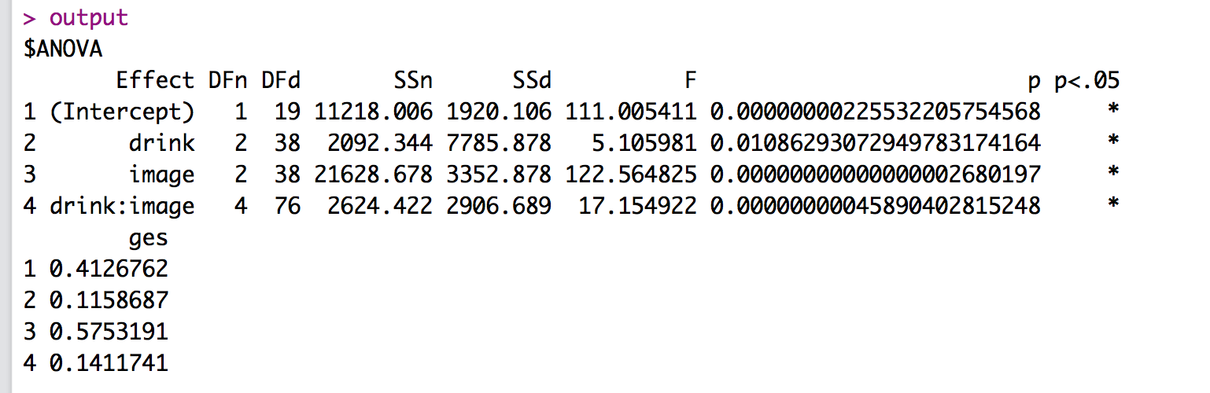
DRINK: F(2, 38) = 5.11, p = .01, Greenhouse-Geiser p = .03, n² = .12
IMAGERY: F(2, 38) = 122.56, p < .001, n² = .58
INTERACTION: F(4, 76) = 17.15, p = .03, n² = .14

Slide 43
All the effects!
What now?
You can analyze main effects and interactions or just interactions
Given examples in code how to do both.
IMPT! Add interaction_average = TRUE, to get the correct main effects using Tukey!

Slide 44
Simple Effects Analysis
Pick a direction – across or down!
How many comparisons does that mean we have to do?

Slide 45
Simple Effects Analysis
Same rules apply as two way between
Split the data:
First SPLIT by the larger number of levels.
Let’s split by imagery, since they are equal here.
Then analyze the data:
Analyze by only the other variable (drink).
Repeat for each data set.

Slide 46
